Slide 1
First-Episode Psychosis (FEP) Series: Empowering Mobile Crisis Teams to Recognize and Respond to People Experiencing FEP
Session 3: Follow-up Check-Ins: Connection to Ongoing Services and Coordinated Specialty Care (CSC)
Apurva Bhatt, MD​​ (she/her/Dr.)
Katherine Pierce, PhD (she/her/Dr.)
April 23, 2025

Slide 2
California Land Acknowledgement
We acknowledge that this training is taking place throughout the unceded territory of California home to nearly 200 Tribal nations. As we begin this event, we acknowledge and honor the original inhabitants of our various regions. A land acknowledgement is a critical step towards working with Native communities to secure meaningful partnership and inclusion in the stewardship and protection of their cultural resources and homelands. Let’s take a moment to honor these ancestral grounds that we are collectively gathered upon and support the resilience and strength that all Indigenous people have shown worldwide.
Adapted from California Indian Culture and Sovereignty Center (CICSA), 2019
Notes:
Danielle

Slide 3
The Importance of Today's Training
Mobile crisis team members (MCT) may not be familiar with the Coordinated Specialty Care (CSC) model, including key components, accessibility, and eligibility criteria.
Not everyone is a right fit for CSC engagement, and discussion with individuals and families experiencing first episode psychosis (FEP) is vital.
Today’s training is intended to empower MCTs to feel better equipped for coordinating care and ongoing support for individuals and families experiencing FEP across systems of care.
This includes recovery-oriented, trauma-informed, and person-centered approaches.
Notes:
Danielle
Today's training is presented in partnership with the California Collaborative Statewide Early Psychosis Program Evaluation (EPI-CAL) workgroup and we are so excited to bring their expertise to the field of mobile crisis response!
MCTs are working directly in the community and come across a never-ending spectrum of different types of crises. Having this foundational knowledge of psychosis is crucial in delivering safe and effective mobile crisis services to the community that reduces the of restrictive interventions. Without proper knowledge and skills for working with individuals experiencing psychosis we can potentially cause harm to the individual and family in crisis. And at large the community.

Slide 4
Today’s EPI-CAL Presenters
Apurva Bhatt, MD​​ (she/her/Dr.)
Clinical Assistant Professor Stanford University Department of Psychiatry​​ & Behavioral Sciences Director, Stanford Child INSPIRE Clinic EPI-CAL TTA Psychiatric Provider Team Lead
Katherine Pierce, PhD (she/her/Dr.)
Staff Psychologist, UC Davis Department of Psychiatry and Behavioral Sciences, EPI-CAL Program EPI-CAL TTA Outreach Team Lead

Slide 5
Learning Objectives
Describe appropriate follow-up check-ins after a mobile crisis encounter with a member experiencing psychosis.
Discuss the importance of recovery-oriented, trauma-informed, and person-centered approaches in understanding the service/support elements of CSC and local eligibility requirements.
Describe major components of CSC and how they may differ between programs.
Notes:
Danielle
Again, Today's session is the first in a series of four trainings, the goal of this training is to establish a baseline understanding of psychosis generally and introduce the concept of first episode psychosis.
You will learn about the prevalence, origins, symptoms, and impact of psychosis and the importance of a person-centered approach
We will discuss how individual experiences of psychosis occur across a spectrum which will help mobile crisis teams understand that individuals with psychosis can sometimes be safely stabilized in the field.
In upcoming trainings, you will learn specific crisis assessment and intervention strategies for individuals experiencing FEP and best practices for referrals and follow-up care.

Slide 6
The Primary Goals for Mobile Crisis Teams
Providing relief and de-escalation in the moment through the least restrictive means.
Meeting the individual where they are.
Listening, building trust, engaging, and partnering with those in need.
Ensuring member safety.
Understanding everyone's individual needs and preferences.
Instilling hope for the future.
Follow-up and linking the individual and/or family to services and support.
Notes:
Danielle

Slide 7
The Follow-Up Continuation of Care

Slide 8
What is a Follow-Up in a Mobile Crisis Encounter?
The purpose of the follow-up is designed to support continued resolution of the crisis, as appropriate, and should include the creation of or updates to the member’s crisis safety plan or additional referrals to ongoing supports, as needed.
If the member received a referral to ongoing supports during the initial mobile crisis response, as part of the follow-up, the mobile crisis team shall check on the status of appointment and continue to support scheduling, arrange for transportation, and provide reminders as needed.
Notes:
Danielle: Mobile Crisis Teams shall ensure that members receive a follow-up check-in within 72 hours of the initial mobile crisis response

Slide 9
Best Practices for Follow-Up After a Mobile Crisis Encounter
Ask if any suggestions offered during the MCT’s intervention were helpful.
Be curious. Ask clarifying questions to show you are listening, as well as to confirm your understanding.
Be ready to repeat information in a concise, calm, and respectful manner. With permission, write down actionable items and resources.
With permission and as appropriate, include family members in the follow-up; they can have valuable knowledge about the person, as well as offer needed support.
Give written and verbal resources that align with the person's and family's needs, and honor their values, culture, and beliefs, including literacy levels and languages.
With agreements in place, provide recommendations for additional engagement with other supportive professionals.
Notes:
Language can help people come together or make them feel disconnected.
Language can help individuals feel heard or ignored.
Language can help make individuals feel validated or misunderstood.

Slide 10
Let’s Look at an Example Situation

Slide 11
The Situation
It is 10 a.m. on a Tuesday morning, and you are called to a single-family home. The caller was a mother who is very worried about her teenage daughter's mental health.
When you arrive, you find that the daughter, Bri, has locked herself in the bathroom, is declining to exit, and does not want her parents to make her go to school. Speaking through the door, Bri tells you that she is afraid to leave the house as a "dark creature" follows her when she sets foot outside her home. She is terrified that this creature will seriously hurt her or her friends at school and notes that even when she can't see the beast, she can feel its presence right behind her. She says this has been happening for months but has worsened since last week. She is highly distressed and very mad and sad that her parents don't "believe" her. After describing the creature to you, she shouts, "Make it go away! I can't live like this anymore!!"
Bri – 16-year-old
Notes:
Dr. Pierce

Slide 12
The Situation 2
You also talk to Bri's parents.
Her mother, Miranda, wants you to get her daughter to come out of the bathroom and is worried that there may be sharp objects inside or medication she could take to hurt herself. She says that Bri has never tried to harm herself before, but she is concerned that may change with these new developments. She notes that she does not think Bri "uses drugs," but that is a possibility.
Her father, John, says that Bri is "making excuses" and is avoiding school because "it's finals week," and she has been very anxious about her grades. He says if you cannot get Bri out of the bathroom he will "break down the door." Miranda mentions that Bri has been hesitant to leave the house lately and keeps asking her if she can "see that thing."
Miranda & John –Bri’s mother and father
English is their preferred language.

Slide 13
What Do We Know So Far?
From Bri's perspective: | From Miranda and John's Perspective:
Risk – Unclear | Risk – worries about self-harm or medication overdose.
Concerns – Feels unsafe and that she may bring danger to her friends at school. | Concerns – Worried about Bri's wellbeing. Concerned about her school attendance.
What makes it worse/better – Not fully clear – Staying in her home seems to help. | What makes it worse/better – multiple ideas of where Bris behaviors are stemming from (drugs, finals avoidance).
Wants her parents to believe her about the creature. Wants the creature to leave her alone. | Wants their daughter to feel safe outside of the house and to go to school.

Slide 14
Identified Supports
Supports for Bri and her family:
Linkages to mental health services, CSC program
Educational supports
Family support
Talk to Bri, John, and Miranda about safety, and determine if a safety plan is needed.
D
What other supports might you offer?
Notes:
To the extent possible, police engagement should be a last resort. When working with families it is important to allow them to determine what best suits their needs, however, we can provide resources and education on the impact of involving law enforcement and potential escalation. Families should know that if they feel threatened and there is an immediate safety risk they should seek immediate help wither through law enforcement or 911.
These were the identified supports during the initial mobile crisis encounter Is there anything additional in regard to support services you might offer?
Should we refer to Coordinated Specialty Care?

Slide 15
Ongoing Support: CSC for FEP

Slide 16
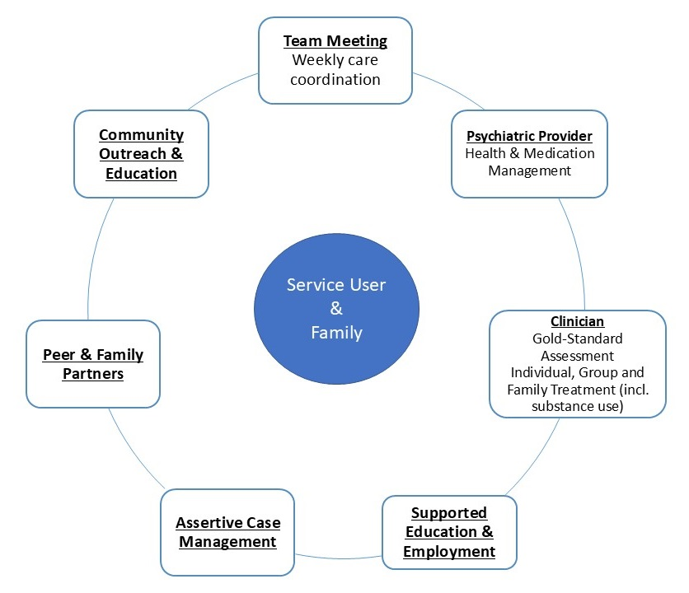
CSC Model
CSC model is a team-based program providing an array of evidence-based interventions for individuals with recent onset/FEP.
EPI-CAL's CSC model focuses on both the participant AND their family/caregivers /support persons.
EPI-CAL CSC model
EPI-CAL CSC model
Notes:
D. Pierce

Slide 17
CSC Model Continued
Most CSC programs have specific requirements (e.g., age, diagnosis, length of psychosis).
Comprehensive assessment at intake helps to clarify the experiences that are impacting the individual.
The focus is on understanding the individual’s needs, values, and goals, which may or may not include reducing experiences of symptoms.
Models include Supported Education and Employment, Assertive Case Management, and family communication.
Care is actively coordinated across a team of providers to support goals and reducing experiences that are disruptive to the person's sense of wellbeing and success across life domains.
Peer and family partners provide lived experience perspectives, support, and hope.
Programs do not expect that individuals are open to or interested in all services or that they endorse having a specific mental health diagnosis.
The teams take a shared-decision making approach to matching services with needs and goals as they evolve over time.
Read, H., Kohrt, B.A. (2022). The History of Coordinated Specialty Care for Early Intervention in Psychosis in the United States: A Review of Effectiveness, Implementation, and Fidelity. Community Ment Health J 58, 835–846. https://doi.org/10.1007/s10597-021-00891-w
Notes:
D. Pierce
Trying to work with the state to move to a broader diagnostic understanding for criteria at this point this can be required (diagnosis). Families and individuals sometimes will want or have diagnoses that are helpful to them and reduce stress.

Slide 18
Is CSC the Right Fit?
As we consider the content today, please remember that CSC aims to offer non-coercive, person-centered, culturally-informed, family-inclusive, trauma-sensitive, and developmentally informed mental health treatment services and supports.
CSC will be a good fit for some but not others, and there will be individuals you meet individuals you meet who are already participating in a CSC program.
Keep in mind that many people are concerned about experiencing stigma in their interactions and disclosures about psychosis to other people, including mental health professionals. This training provides useful information to help you provide respectful and validating support to all.
Notes:
D. Pierce
For example, for some folks religious/spiritual places and cultural practices at home might currently be a better fit for their healing journey and for others, it may be healing/wellness centers or peer-led programs. Additionally, people change their minds and perspectives about what kinds of care they want and need to address their mental health experiences.

Slide 19
Community Education
CSC programs often provide ongoing outreach and education across community groups.
Some communities have a strong understanding of local CSC services. Others are just getting started.
Your assistance in getting the word out can make a difference!
As a crisis team member, you and your colleagues might encounter individuals who are already familiar with local CSC program(s).
It's important to emphasize hope and recovery potential through early connection to support.
Notes:
D. Pierce

Slide 20
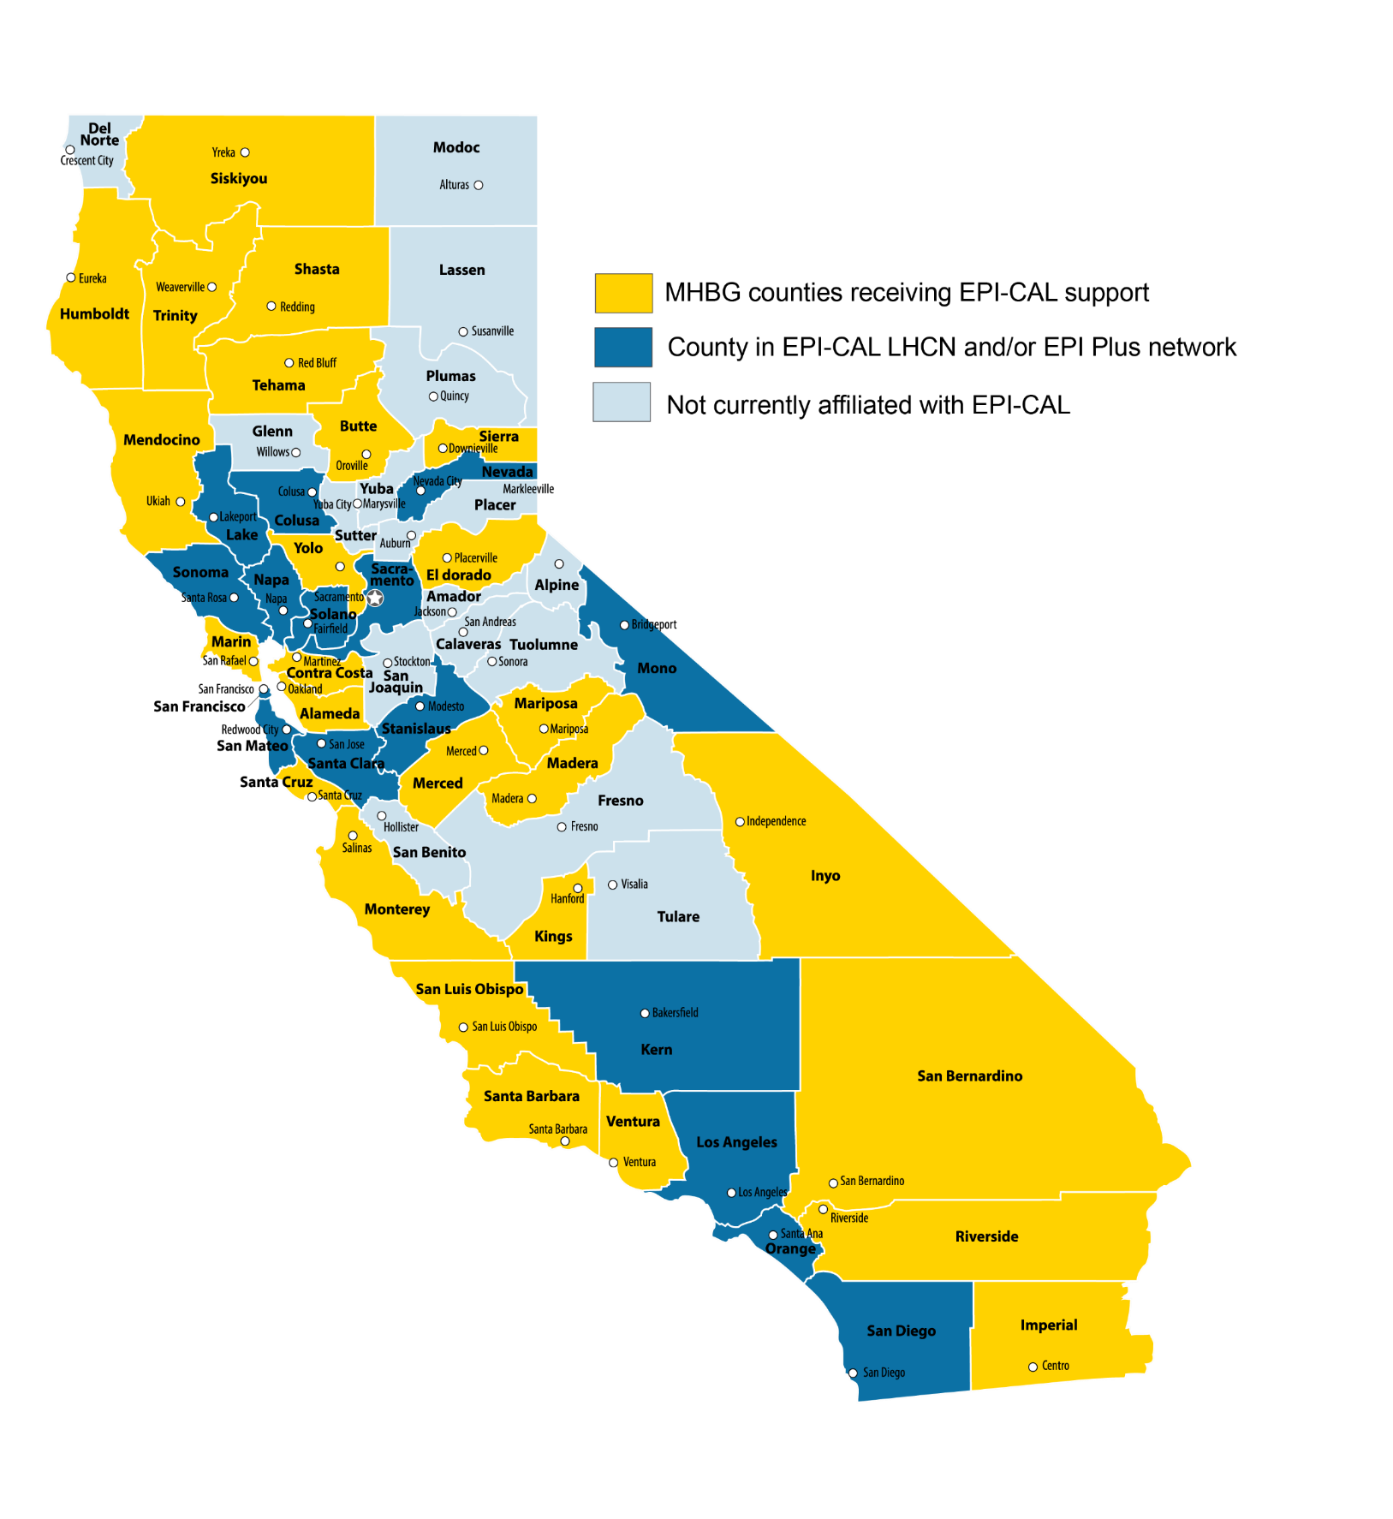
CSC in California
EPI-CAL is working to support access to CSC services throughout California.
Some counties have established programs; other counties are working to implement or build programs.
If your county does not have CSC services right now, consider what services are available and what will be helpful to individuals in crisis.
Notes:
D. Pierce
Dark blue and yellow have programs.

Slide 21
Referral Considerations 1
Understanding how CSC teams approach the service users' (and support persons') goals helps you explain that the individuals will have choices throughout the program.
CSC teams work to match services with people's goals:
Individuals’ goals change over time based on their life circumstances.
Families and young people might have shared OR different goals and needs—this is common!
Modeling low stress, reflective, and active listening will help these efforts.

Slide 22
Referral Considerations 2
When you meet members who might benefit from CSC, keep in mind everyone is working to make sense of these challenging experiences.
Being clear in your description of the CSC model and/or alternative services.
This will help individuals make informed choices about their care.
Practice transparency with everyone. CSC teams use this approach.
Acknowledge the limitations of what you can offer and validate thoughts and feelings about those limitations.

Slide 23
The Role of Family Members and Support Persons in the Check-in
Family and support persons can always provide information to the team.
Conversations that focus on shared concerns and shared goals are most effective.
Statements that imply an individual is impaired or unable to make decisions are not helpful and can be stigmatizing. Choose language that separates the person from the experiences causing concern.
Participation in services is up to the individual.
Notes:
Dr. KHL

Slide 24
The Role of Family Members and Support Persons in the Check-in
Cultural differences can impact family comfort with transparent conversations.
For example, a parent might not want to share their concerns with their young person present and vice versa. You will need to negotiate the situation calmly and directly.
Offer to do some brief problem-solving to better understand their needs and find additional solutions. This can alleviate additional stress for the family.
Call people by their preferred name and pronouns, if provided.
Avoid using terms like "Mom," "Dad," or "Sister" when directly addressing the individual unless you are told otherwise by the person.
Notes:
Dr. KHL

Slide 25
Common Concerns about Participation in CSC 1
During follow-up, crisis teams may encounter individuals that are reluctant, concerned, or conflicted about agreeing to CSC services.
CSC programs do not expect or require a person to agree to all CSC services and supports.
What matters most is the individual is heard. Services should be described in a way that aligns with the expressed needs, concerns, and hopes of the individual and family.
Notes:
Dr. Pierce

Slide 26
Common Concerns about Participation in CSC 2
The individual may feel pressured to agree to an array of services that may communicate a message of severity, which may deter individuals or families from participating.
The individual or their family may have had historical experiences with social institutions and systems that were harmful.
Medications are one tool for recovery, but individuals may choose not to use them or may receive support to stop. CSC medical providers support these choices in a collaborative manner.
Notes:
Dr. Pierce

Slide 27
Culturally Responsible Practices in Follow-Up Care
Individuals who experience race-based marginalization are often perceived to have more severe mental health symptoms than their same-age peers who do not share these identities. This can lead to unhelpful interventions or interventions that are unnecessarily restrictive or coercive.
Black / African-American men are often over-diagnosed with psychosis.
Asian American, Native Hawaiian, and Pacific Islander individuals are often under-diagnosed with psychosis.
Notes:
Dr. Pierce

Slide 28
Follow-up: Culturally Responsible Practices
Develop a routine of reflecting on and discussing your own biases and assumptions with trusted colleagues and/or supervisor/team leader. Seek trainings in cultural humility.
Welcome diverse explanations for what is going on and explanations of experiences, including multiple explanations at once for all individuals.
Ask who and what might be missing from resources, and offer examples to help solicit input. (For example: Are there any leaders from your community who we might want to call? Is there a group/individual you feel comfortable with to discuss your concerns and feel connected/less isolated?)
Notes:
Dr. Pierce

Slide 29
What Questions Do You Have About CSC?
Feel free to raise your hand.
Notes:
Dr. Pierce
Interaction/audience prompt for response is contingent on timing
Please place your Reponses in the chat or raise your Emoji hand to unmute.

Slide 30
How is the CSC Model Similar or Different From Your Experiences and Practices?
Feel free to raise your hand.
Notes:
Dr. Pierce
Interaction/audience prompt for response is contingent on timing
Please place your Reponses in the chat or raise your Emoji hand to unmute.

Slide 31
Follow-Up in Practice

Slide 32
The Situation: Revisited 1
Three days have passed since you spoke to Bri and her family. You have returned to their home for your follow-up check-in. You start the conversation by reviewing the concerns they shared during the crisis call. Each person has agreed to sit in the same room with each other, but tensions are high.
John has shared that his brother has had experiences of seeing and hearing things others could not, and that he is worried Bri is experiencing the same things. He is hoping that this can all be explained by something else. Miranda is worried because Bri is starting to approach her maximum number of missed school days and does not want her to be held back a grade.
Bri shares that she has not left the house since you last visit. She says she is terrified to look out the windows in case the creature is out there waiting for her. She says this started several months ago, and she used to just have a feeling that there was a presence following her, but it has grown stronger and taken on a form since then. She has tried to use prayer to help feel better, but otherwise she has covered the windows in her room to feel safe. She is confused about what is going on and is not sure what to do, especially because she feels like no one believes her or takes her seriously. She just wants someone to talk to and for the creature to go away – so that she can get back to her life and see her friends at school.
How could CSC help? What's next?
Notes:
Dr. KHL
Danielle may tag in as needed.
Old start: It's now midnight. You have listened and check-outed out for accuracy, what you heard the son and father communicate about their concerns.
You may have noticed that the pastor has been involved in this scenario. As we previously discussed, engaging families and their natural and community supports can often times provide relief and alternative ways for families to seek support and respite. In this case father an son were open to engaging their pastor which supported their conversation and working towards resolution.

Slide 33
The Situation: Revisited 2
“Thank you all for sharing your concerns and meeting with me again. It sounds like everyone would like to learn more about what is going on, and how we can help Bri stay safe and get back to her friends."
Have you had a chance to follow up with the CSC team?
Reiterate what services detailed in the first visit may be helpful.
If a safety plan was needed, follow up on necessary steps (e.g., removing sharp objects, medications).
Discuss indications when to go to the ER/call 911.
Notes:
Dr. KHL
Old start: It's now midnight. You have listened and check-outed out for accuracy, what you heard the son and father communicate about their concerns.

Slide 34
Application to Mobile Crisis Response
Resources in every community are different and vary.
Making these connections and knowing your community is important.
Identify what support services and programs are available. Including their capacity, wait times, and participation criteria. If a CSC program is not available in your community, how can you leverage other resources and supports for individuals experiencing FEP?
Meet the individual and families where they are.
Not everyone will be open to the options you want to provide. Listen to understand what support services might be the best fit.
Voice and choice matter.
Notes:
Danielle
Upcoming resource on M-TAC Website- FEP map resource M-TAC is developing for counties to be able to search by county/region available FEP/CSC resources.

Slide 35
Key Takeaways for Effective Follow-Up Care
Reconnect
Recap
Resource
Take the time to refresh the personalized, validating connections made during the first response, and set the tone for the follow-up connection.
With the person and their family, recap the experience. Check-in with each person to be sure your recap reflects their experiences.
Talk about what has gone well and what could be better from each person's perspective.
What connections were useful/successful?
Are different resources needed? Could CSC be useful?
What other actions, relational interactions, or daily strategies have been or might be helpful?
Notes:
Dr. Pierce
Psychosis looks different for everyone; psychosis is unique, and there is no universal presentation​.
Language is key. Avoid confrontation, speak in a calm and reassuring tone, use simple language, and focus on validating their feelings without validating the content of their delusions. ​
Use active listening. Pay close attention to what the person is saying and try to identify activations that may be contributing to their distress. Show up with a lens of trying to understand their experience and what is happening.​
Have empathy and a nonjudgmental approach. Try to understand the person's perspective and avoid dismissing their experiences​.
View the person holistically and consider any natural supports that can help in keeping the person safe without using restrictive interventions​.

Slide 36
Psychosis is Unique for Everyone, and Recovery is Too.
It is important to adjust care to meet an individual's needs. Having a comprehensive assessment is an important first step.
Common treatments/interventions may include the following:
Therapy
Integrating families into therapy
Medication management
Substance use management
Supported education/employment
Cognitive remediation
Skills training
Peer/family support
Notes:
Dr. Pierce
Presenter: important to highlight what a good assessment looks like

Slide 37
Everyone’s Experience is Unique. The Most Important Thing is to Listen.
Notes:
Danielle to close out
As we come to our end, I want to thank the EPICAL team for their partnership on this series and training today. I want to thank all of you in the room here today for the valuable life saving work you do out in the community. You mater and you make a difference in the lives you touch every single day, thank you.
And lastly, I will leave you all with this gentle reminder... listening in mobile crisis response is key. Listening supports understanding what the person in crisis is experiencing and what is happening to them. Facilitates their voice and choice and is a collaborative approach. Listening supports keeping an individual in crisis safe without restrictive intervention (i.e. hospitalization, etc…). Listening builds trust and rapport. Listening is an intervention!

Slide 38
Questions?

Slide 39
Thank you!

Slide 40
References
Benuto, L.T., Done, M., Zepeda, M., Fitzgerald, J., & Leany, B. (2023). A systematic review of persons of color participation in first episode psychosis coordinated specialty care randomized controlled trials in North America. Psychiatry Research, 325, https://doi.org/10.1016/j.psychres.2023.115221
Daley TC, George P, Goldman HH, et al. Client Racial Composition in First-Episode Psychosis Programs Compared With Compositions in Program Service Areas. Psychiatric Services (Washington, D.C.). 2022 Dec;73(12):1373-1379. DOI: 10.1176/appi.ps.202100587. PMID: 35652193.
DeTore, N, Ventura, J, Subotnik, K, and Nuechterlein, H. (2018). Family burden predicts functional outcome in the early course of schizophrenia beyond psychiatric symptoms and baseline functioning. Schizophr Res. 2018 December ; 202: 328–332. doi:10.1016/j.schres.2018.06.068
Keith Chan, Keith T. Chan, Meirong Liu, Addressing Anti-Asian Racism with Social Work Advocacy and Action. (2024). United States: Oxford University Press, Incorporated.

Slide 41
References (cont.)
Kim, P. Y., & Lee, D. (2014). Internalized model minority myth, Asian values, and help-seeking attitudes among Asian American students. Cultural Diversity and Ethnic Minority Psychology, 20(1), 98–106. doi: 10.1037/a0033351
Naito, T., Chin, J., Kim, T. U., Veera, S., Jeannette, M., & Lomiguen, C. M. (2020). Further reduction in help-seeking behaviors amidst additional barriers to mental health treatment in Asian populations: a contemporary review. Cureus, 12(11). doi: 10.7759/cureus.11455
Read, H., Kohrt, B.A. The History of Coordinated Specialty Care for Early Intervention in Psychosis in the United States: A Review of Effectiveness, Implementation, and Fidelity. Community Ment Health J 58, 835–846 (2022). https://doi.org/10.1007/s10597-021-00891-w
Warner, A., Smith, W. R., & Tsai, J. (2022). Coordinated Specialty Care: Progress and Future. Psychiatric Services, 73(12), 1319–1319. https://doi.org/10.1176/appi.ps.22073016
Wu, E. D. 2014. The Color of Success: Asian Americans and the Origins of the Model Minority. Princeton, NJ: Princeton University Press.

